Slide 1

Arduino Uno Quick Start Guide
Manuel Kelly

Slide 2
What is an Arduino Uno?
An Arduino Uno is an open-source Microcontroller made by Arduino.
Microcontrollers are very useful for control systems. (Such as Remote-Controlled Vehicles, Particle Detectors, and even 3D printers)
Some small applications of a Microcontroller would be fans controlled by a temp sensor (such as an AC system) or even real time audio filters.
The Arduino Uno is a very cheap platform that utilizes the C++ HLL.

Slide 3
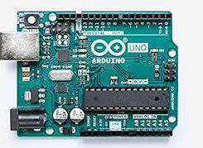
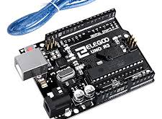
Arduino Uno Quick Look

Slide 4
C++ Basics

Slide 5
DISCLAIMER
This is not a full tutorial on C++.
We just need to know enough to perform basic functions on the Arduino.
To learn about this language in depth, follow this link for more information.
This PowerPoint and Code developed will be available in the GitHub in the description.

Slide 6
Variables
One of the basic elements used in C++ programming.
Are used to store values for functions.
There are many different types of variables in the C++ language.
We will be using these frequently with the Arduino Uno.

Slide 7
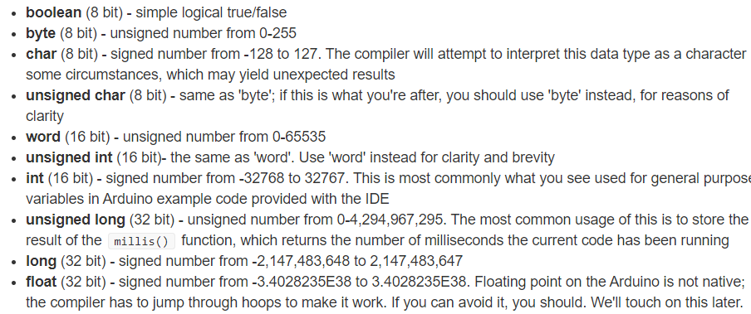
Variable Types
double (64 bit) – Floating point number but uses double the amount of bits. This is useful for very large numbers.
string – An array of char variables used to create full words or sentences.
Link to the listed variables

Slide 8
Variable Allocation
Can be allocated as a Global or Local Variable.
Global Variable: A variable created outside of a function.
Typically used when we want store or manipulate data without losing it after a function has been executed.
Local Variable: A variable created within a function.
Typically used when we need a “one-time use” variable that is no longer needed after a function has been executed.
Static Variables: A variable created within a function that stores data similar to a Global Variable.

Slide 9
Functions
Functions allow a programmer to execute many lines of code with a single function call.
Functions are written by a programmer and are task specific.
For example: If I want to program an RGB LED to cycle through all colors (ROYGBIV), I can call a function to do so.
Functions can also return data types.

Slide 10
Arduino Functions
When creating a new Project, the Arduino IDE provides 2 functions.
The first function is called setup and it is used to determine which pins you will use.
The second function is called loop and it is used to perform tasks on the pins selected.
For simplicity, we will only use the two functions above for our future projects.

Slide 11
Libraries
Libraries are a core fundamental of programming in C++.
Libraries contain pre-made functions that allow the user to perform tasks simply.
For example: If we want to use an LCD display, Arduino has a built library that allows for easy programming of that display.
There are dozens of useful built-in libraries, and they are all listed in this link.
If a library is to be used, I will explain what it does during the programming stage.

Slide 12
Arduino Input and Output

Slide 13
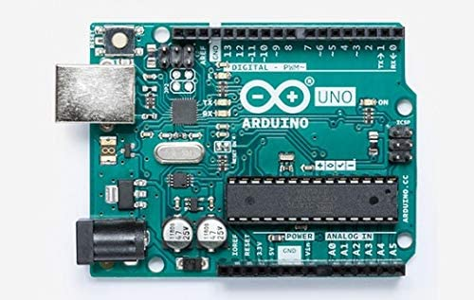
Arduino Uno Pins

Slide 14

Programming on the Arduino

Slide 15
IDE and Useful Software
The Arduino IDE can be downloaded at this link.
For serial communication with the Arduino, we can use a program called PuTTY to display text to our PC screen.
Here is the link to download and install PuTTY.

Slide 16

First Program {}

Slide 17
“Hello World!”
We will use PuTTY and the Arduino’s Serial Communication to output the phrase “Hello World!” to our monitor.
We will now open the Arduino IDE and PuTTY.

Slide 18
Second Program {}

Slide 19
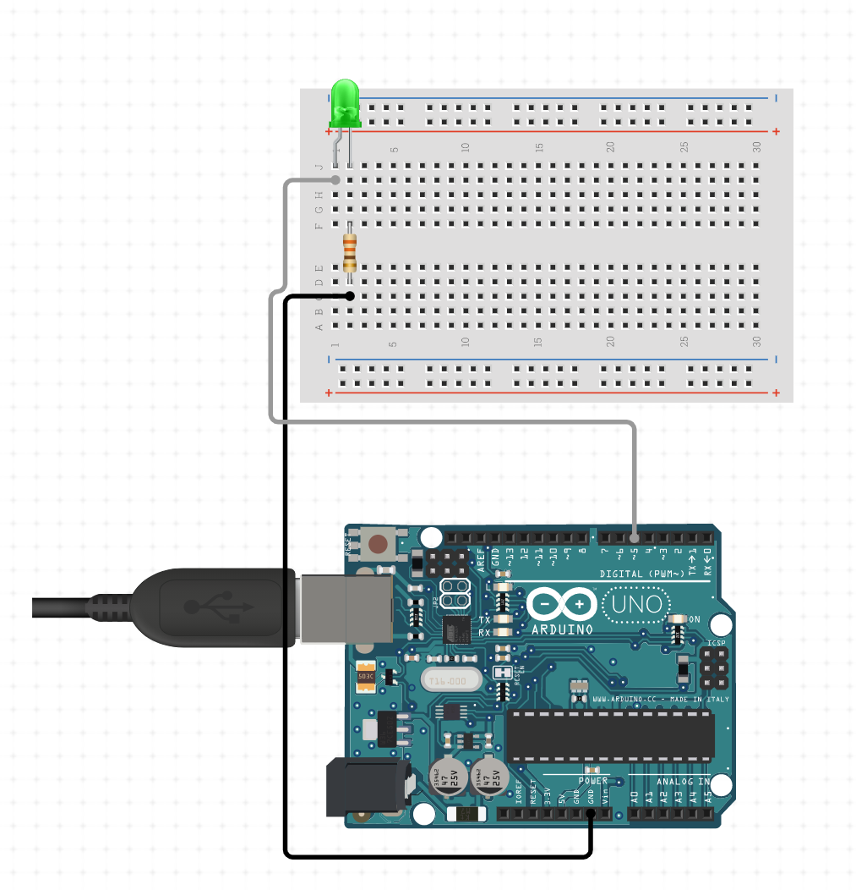
Blinking LED
We will create a simple program that will blink an LED using the Arduino Microcontroller.
The following pin diagram will be used.
We will now open the Arduino IDE.

